Slide 1
KID Viewer
Jonah Lee - Feb 12 2024

Slide 2
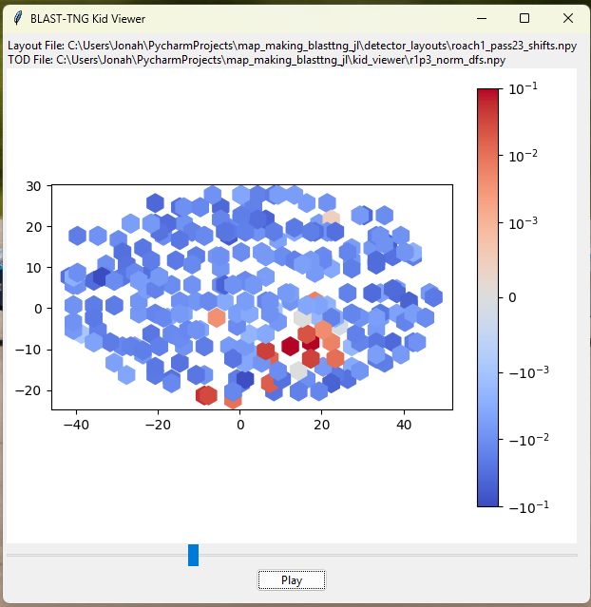
Purpose / Motivation
Understand what the detector array is “seeing”
Qualitative overview of KID signals
Observe noise, bad KIDs, collisions in an intuitive way
Deepen understanding of noise/atmospheric signals vs. geometry
Common-mode is not just one number: we now see how non-astronomical signals can vary over position on the array and over different networks
Find mistakes in KID layout
Ideally this is done well regardless, but viewing these can show if placements are significantly off
Understand time-domain anomalies
We can now see what a spike looks like, and how each KID experiences it differently.

Slide 3
Progress So Far:
Export required data
KID DF dictionary
Layouts (source determined or file)
Process data
Down-sampling (windowed mean)
KID reject removal
Plot animated scatter plot
Can configure colormap, color scale, etc.
Add GUI elements
File Labels
Slider to control time slice
Play/pause button

Slide 4
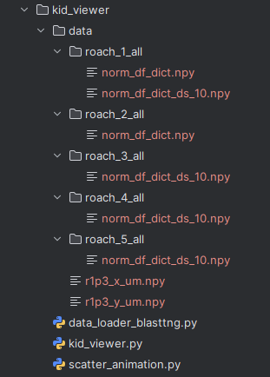
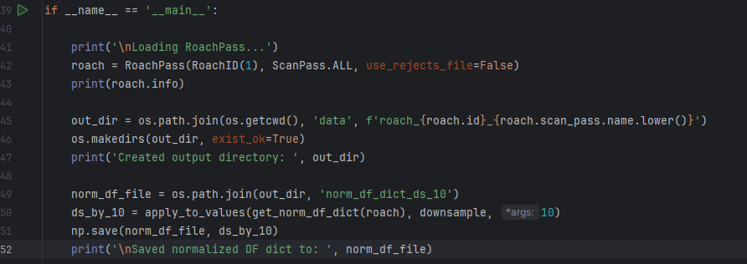
Data Loading Script
Obtain data from control computer & transfer it to local
TODs, shifts, pointing, etc.
download as .npy files
If adapting to CCAT, this is the only stage that must be rewritten
Automatic downsampling to reduce file sizes (ds_10 means windowed mean length=10)

Slide 5
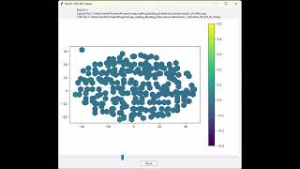
ROACH 1(colour scale is not great): https://youtu.be/SAVW8gYrrRU

Slide 6
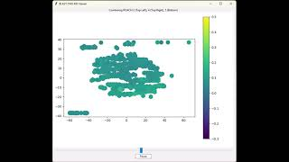
Roach 2+4+5: https://youtu.be/VtQzWOlUiMU

Slide 7
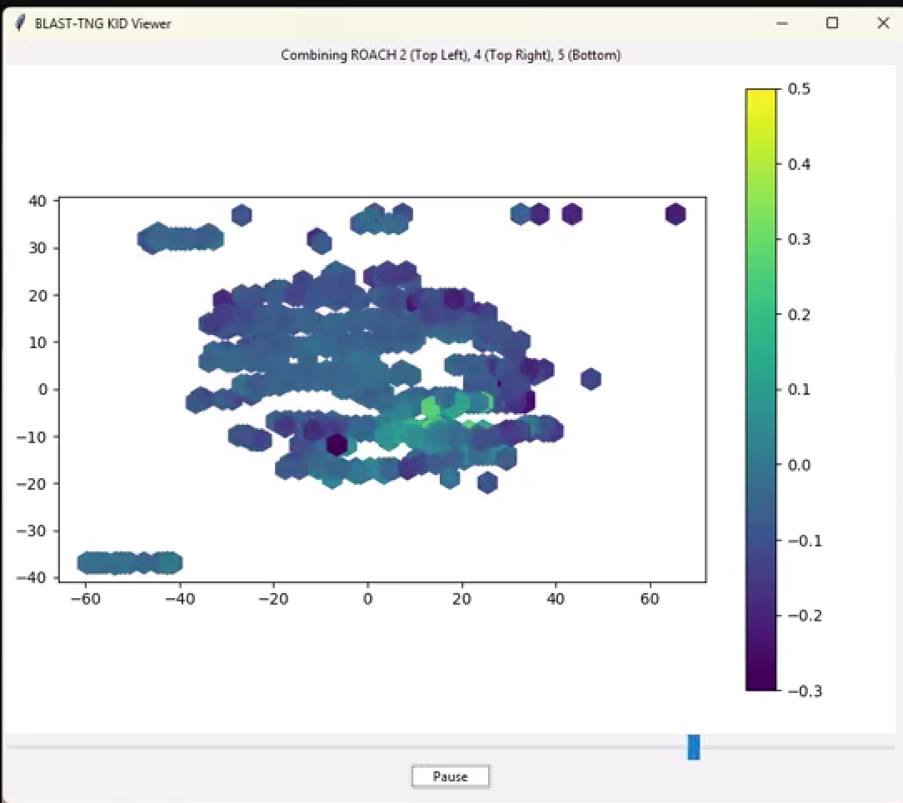
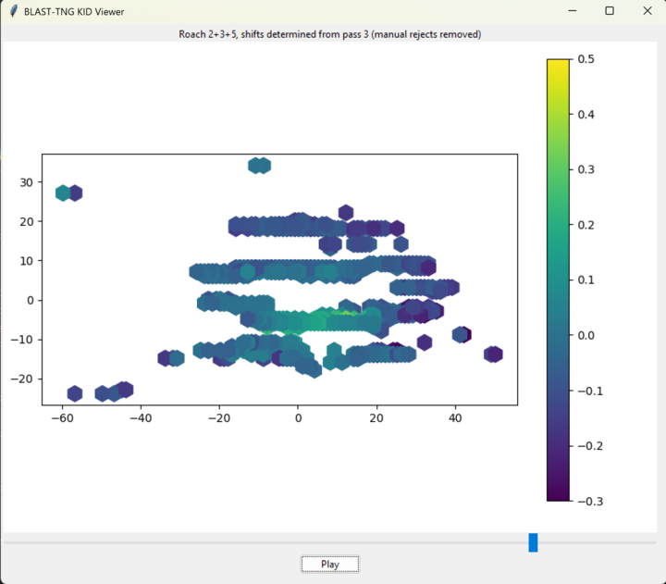
Source Shift Determination
note: left/right timestamps do not match exactly
determined from 3-pass map
determined from third pass only

Slide 8
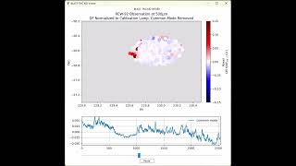
Update (April 24th) - Project Complete
KID Viewer is now merged into https://github.com/jonahjlee/map_making_blasttng_jl
Video sample: https://www.youtube.com/watch?v=PXv1NnYOwtk

